Slide 1
Abeta Prediction
By Kathakoli Sengupta

Slide 2
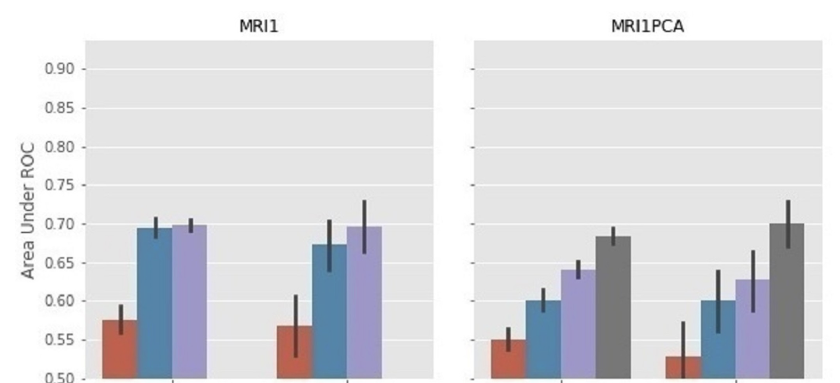
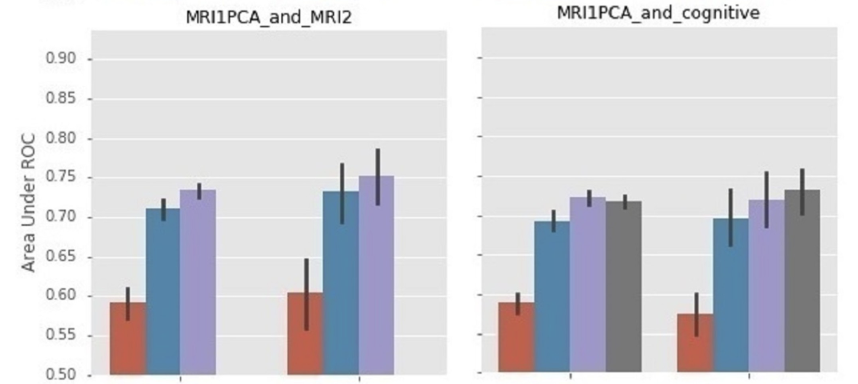
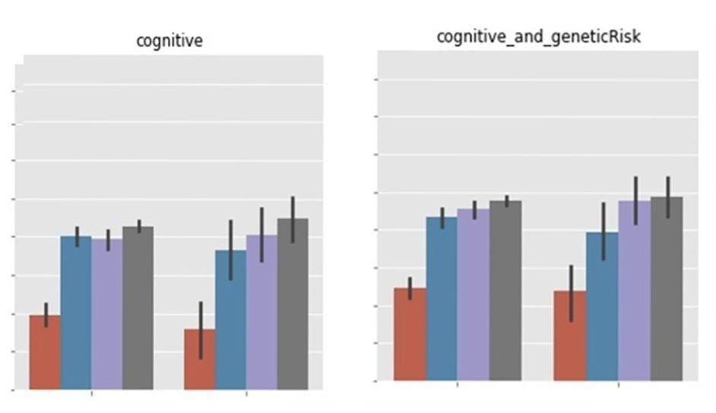
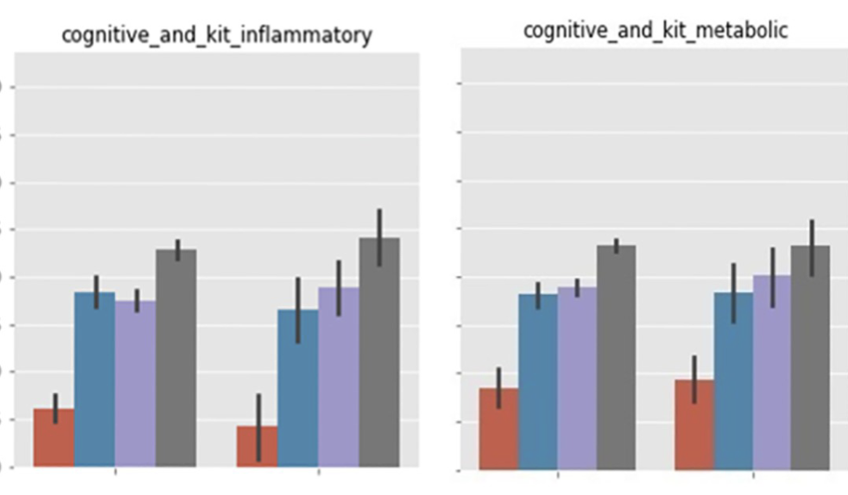
Inexpensive, non-invasive biomarkers predict Alzheimer transition using machine learning analysis of the Alzheimer’s Disease Neuroimaging (ADNI) database
1. The study is focusing on the transition from mild cognitive impairment(MCI ) to Alzheimer’s disease(AD) in certain patients and the main neuropathological factors impacting towards the same is amyloid-beta plaque deposits and hyper-phosphorylated tau peptides.
2. Cart(Classification and Regression Trees), Gradient Boosting (GB) and SVM(Support Vector Machine) classifiers are used for classifying stage of Alzheimer’s among which SVM proves to be the best classifier. Cart’s disadvantage is that it becomes greedy and faces the problem of overfitting after a certain threshold.
3. The models were built on four groups of features MRI (3 baseline representations: MRI1, MRI1PCA, MRI1norm) plus cortical atrophy rates (MRI2); five groupings of plasma biomarkers (RBM kits: “cardiac”, “inflammatory”, “metabolic”, “neuro”, demographics (BMI, Systolic BP, Age, gender) and genetic risk (ApoE4).
4. The literature classified predictions where the mean AUC > 0.7 as ‘useful’, as well as where AUC > 0.75 as ‘good’. ‘Significant’ were those with the entire 95% AUC error bar > 0.7.

Slide 3
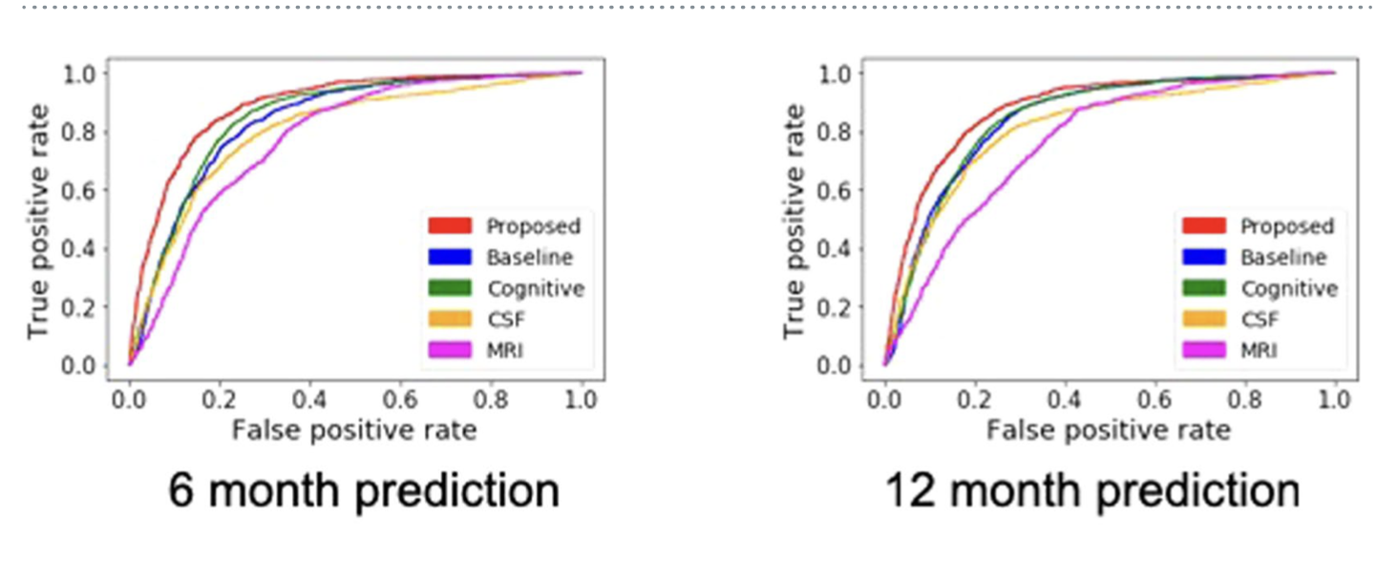
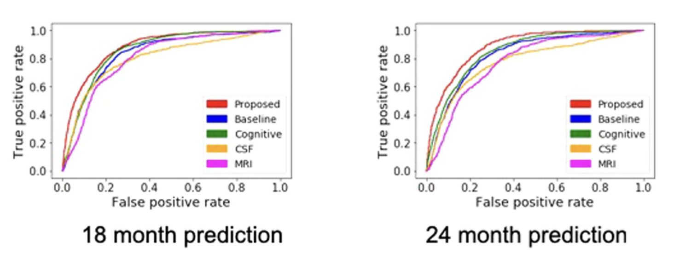
Predicting Alzheimer’s disease progression using multi-modal deep learning approach(Paper)
This study suggests a deep learning model for predicting AD based on four different modes of data and they are cognitive performance, CSF, demographic information, and MRI. While single modal analysis with only cognitive performance showed 75% accuracy, the one with all four modes showed 81% accuracy.
CSF markers here include amyloid-β 1–42 peptide (Aβ1–42), total tau (t-tau), and tau phosphorylated at the threonine 181 (p-tau).
SVM and Locally Linear Embedding(LLE) models are trained with CN and AD patients data and then MCI-CN and MCI-C patients are tested.
The proposed model is the one after training with all 4 modal values and baseline is the one at the first visit.
Others are single modal values.

Slide 4
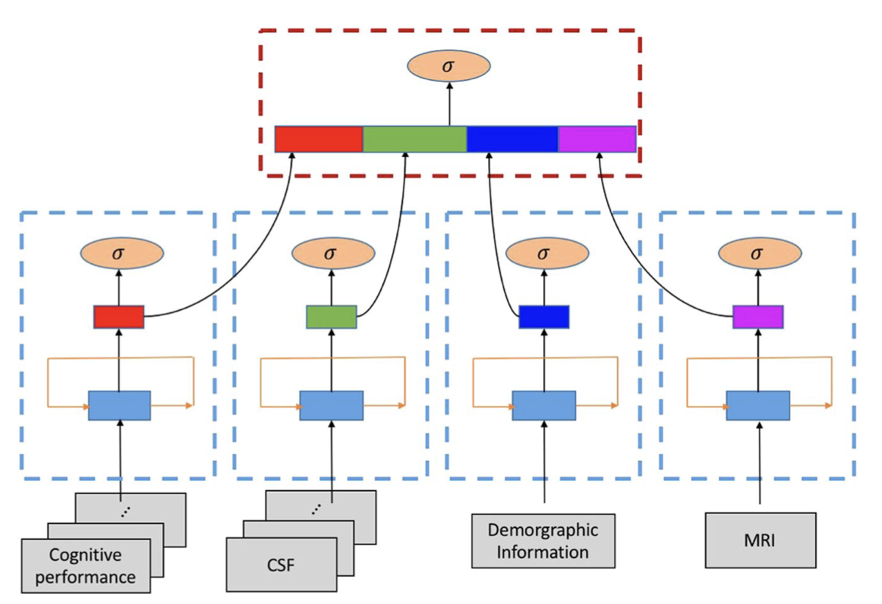
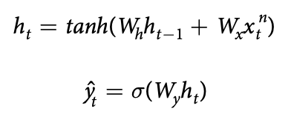
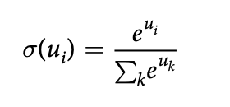
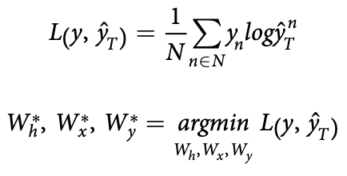
Probability Factor:
GRU with 4 modes
For merging 4 vectors, concatenation based data integration from the GRU outputs is used.
For the final prediction, l1-regularized logistic regression is used for the classification between MCI-C and MCI-NC.

Slide 5
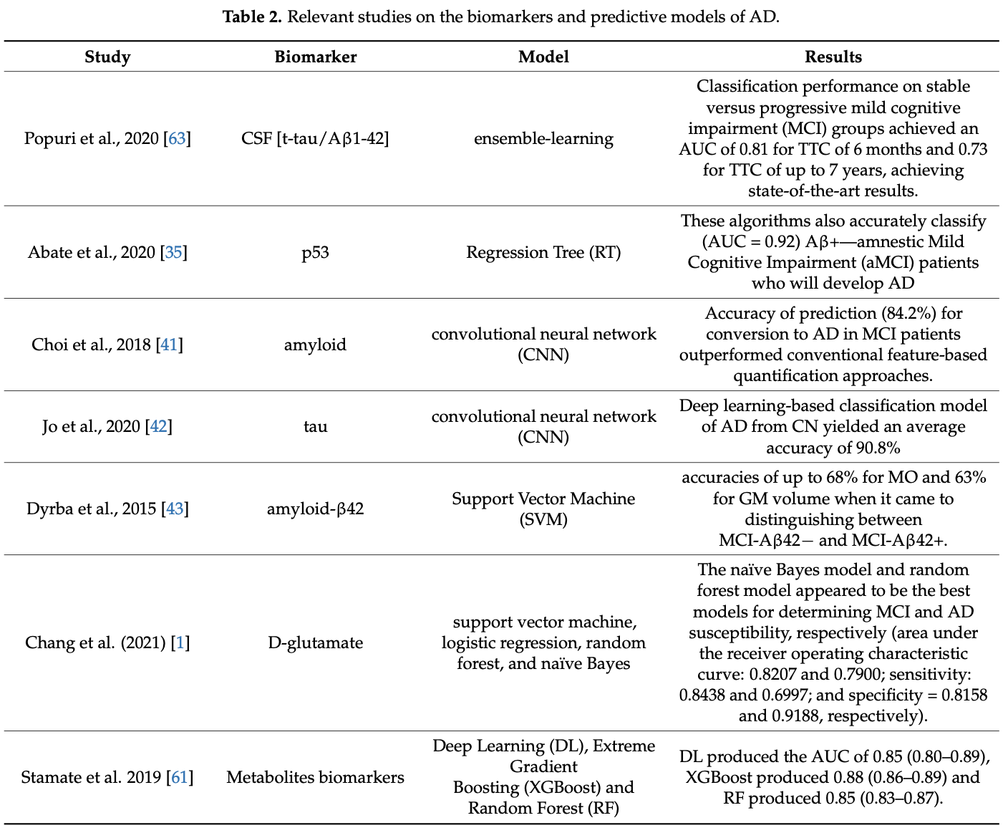
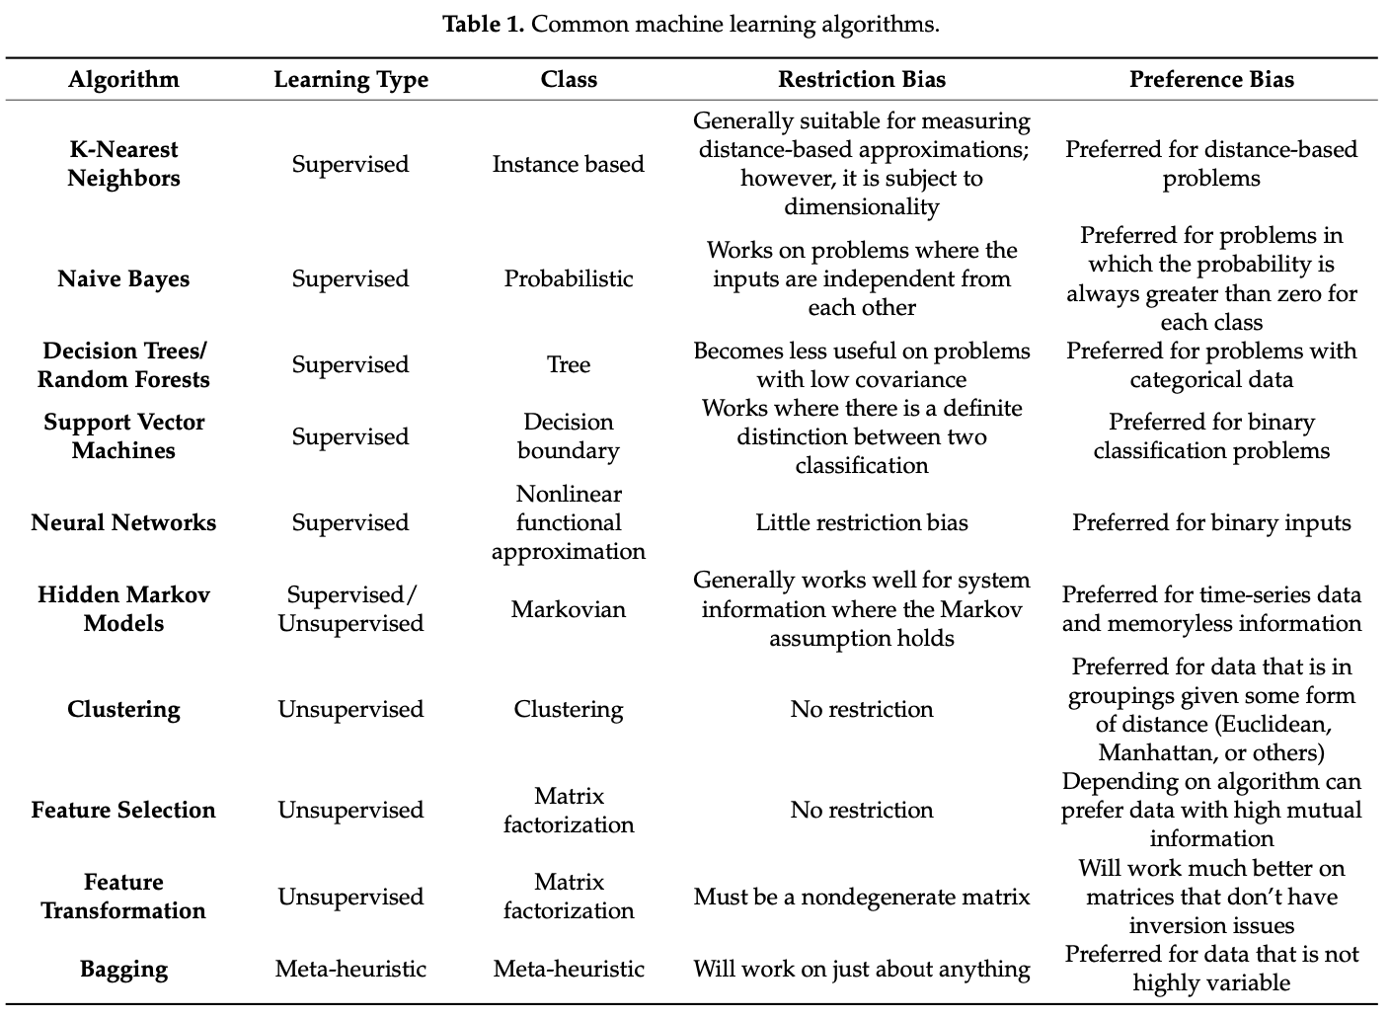
Machine Learning and Novel Biomarkers for the Diagnosis of Alzheimer’s Disease (Paper)
This is a review paper of the studies that has been carried out with important biomarkers and machine learning techniques that can be used with it t0 predict Alzheimer’s disease.
The biomarkers among these which we are concerned with are CSF biomarkers i.e. amyloid beta 42 and ptau. The common machine learning techniques that can be used for classification are also listed below.

Slide 6
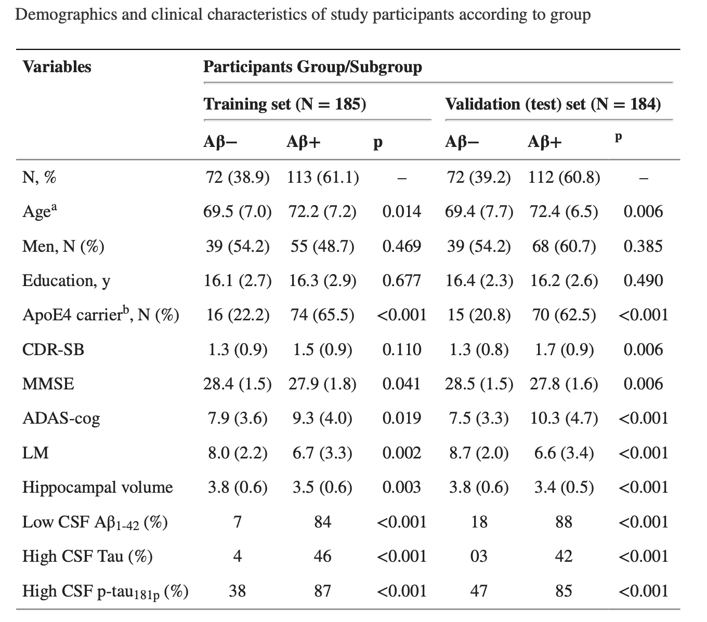
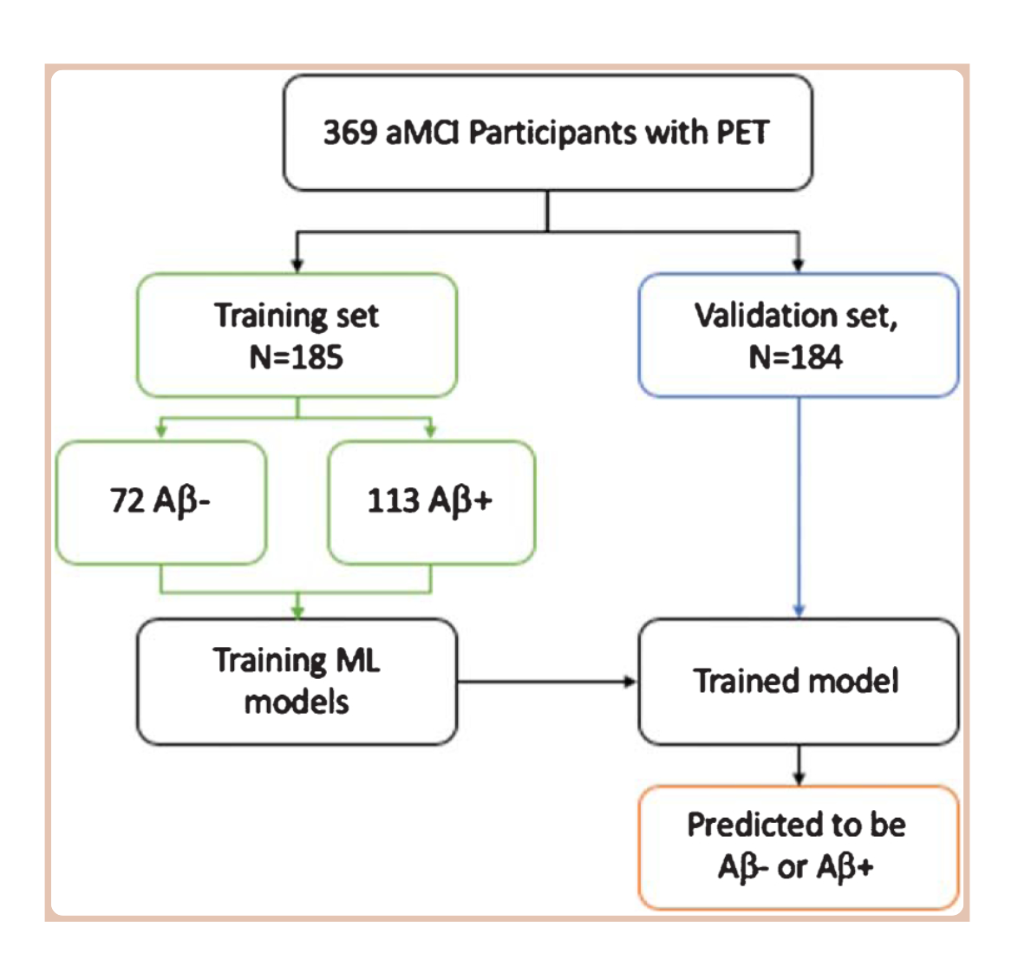
Predicting Amyloid-β Levels in Amnestic Mild Cognitive Impairment Using Machine Learning Techniques (Paper)
The study used different demographic and clinical data of medical patients and fed it in Ensemble Linear Discriminant Classifier(ELD) to predict if the person is A-beta + or not.
The literature lists the features that contribute the most towards the A-beta prediction. They are demographic information like age, sex, education, MRI measures, CSF biomarkers like PTAU, Abeta42/40 ratio, cognitive data like MMSE , hippocampal volume and ICV(Intracranial volume).
3. A AUC score of 86% was observed by the classification model which was trained with only demographics data, APOE4 and CSF biomarkers while a 90% score was observed by the model which was trained with combination of all these features.

Slide 7
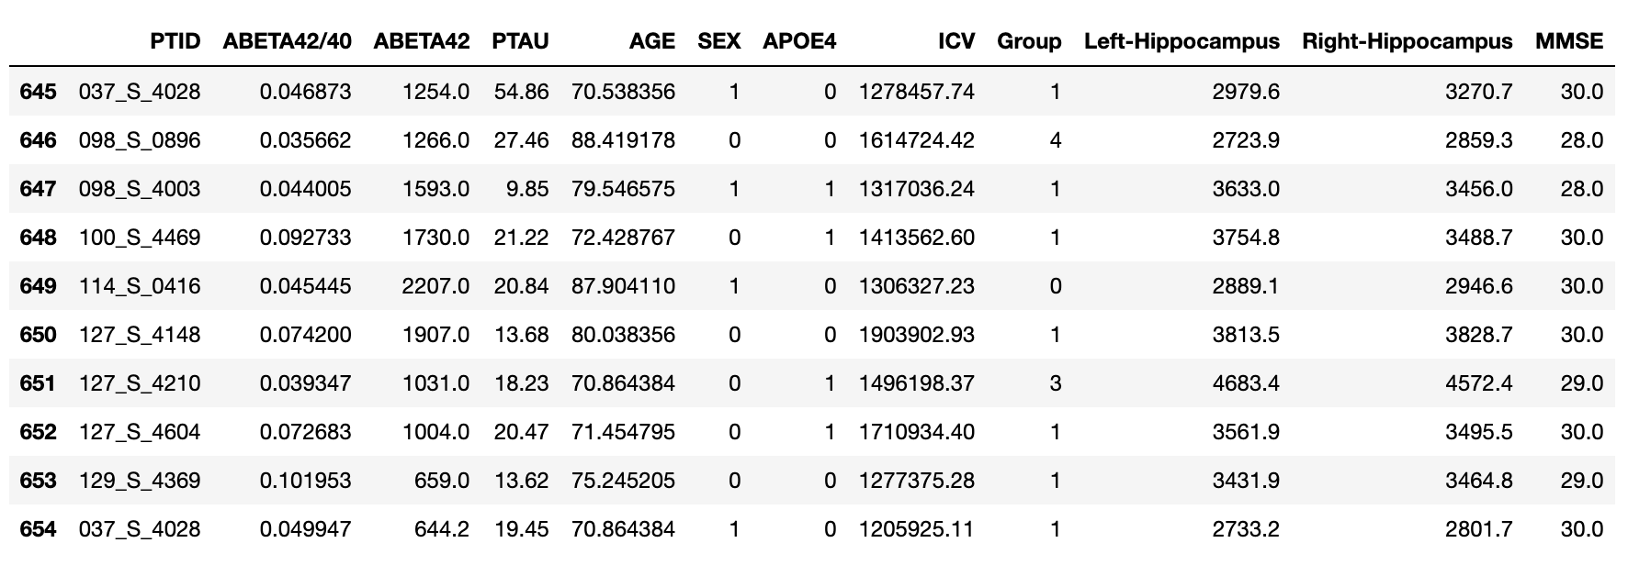
Regression Model
Based on the previous literature, the features chosen are demographic information
(age,sex), APOE4 value, Total Intracranial Volume(ICV),Hippocampus volumes,
Cognitive data(MMSE)(Mini Mental State Examination), ABETA42/40 value and
Groups of Alzheimer’s disease are chosen.

Slide 8
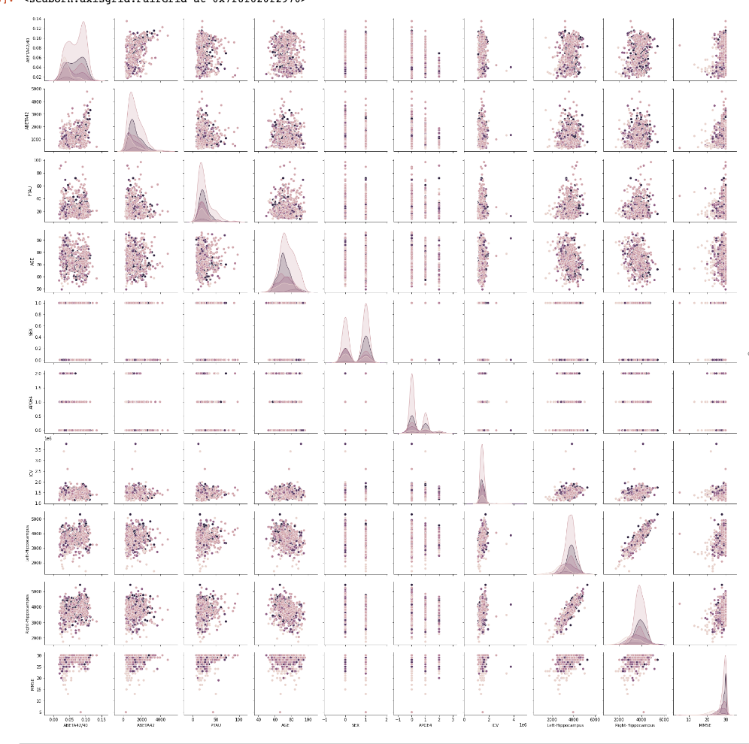
Related Plots
It is very evident that none of the features are showing any trends towards A-beta level. All the plots corresponding to A-beta level are haphazard and spread all over the place.
If analyzed critically it can be seen that for lower values of PTAU, there are high and low A-beta values whereas for higher values of PTAU there is no high A-beta value.
Moreover, for higher A-beta 42/40 ratio there are all ranges of A-beta 42 value whereas for lower ratio only low A-beta 42 values are present.

Slide 9
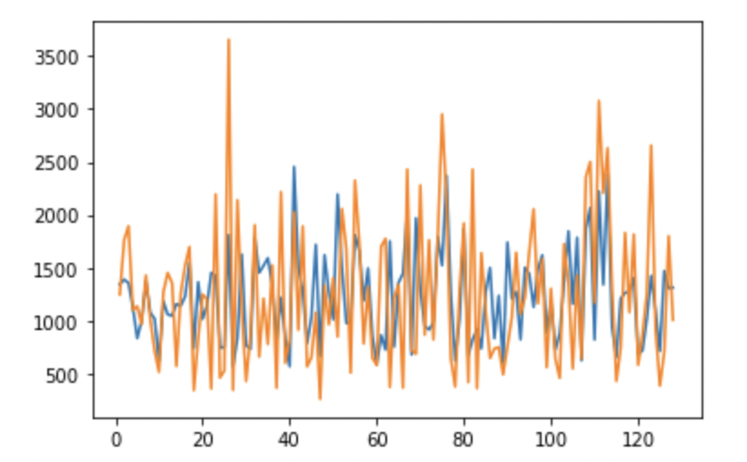
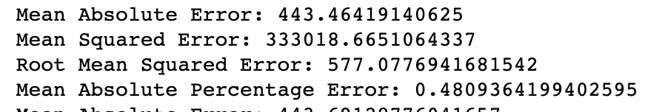
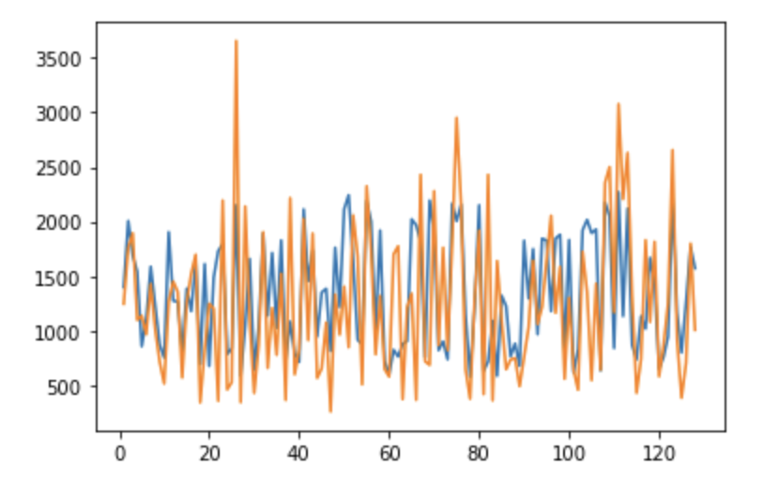
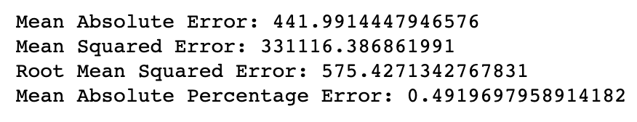
Regressor Outputs
Random Forest Regressor:
48.09% is the least error that this model is predicting which is not a satisfactory error value for designing a model.
MLP Regressor:
49.19% error is present in this sample which does not make it suitable enough for any prediction.
Both the models here are not good enough for A-beta prediction.

Slide 10
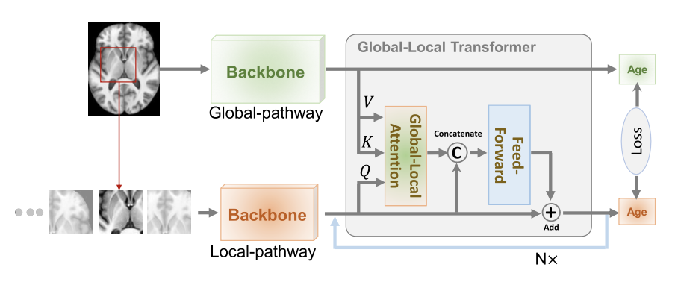
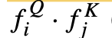
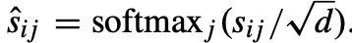
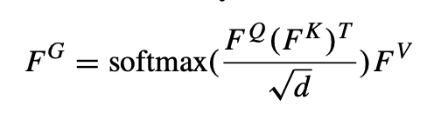
Global-Local Transformer for Brain Age Estimation (Paper)
The diagram shows a global-local transformer for age prediction of the Alzheimer’s patients from other demographic and brain image features.
For this key and values are computed from global pathway and query from local pathway. The global features i.e. weighted sum( attention) of global values is concatenated to local so that local also has global context information.
Global Attention:
Where sij=
And global-context local features become
Github Repo: https://github.com/wangyirui/AD_Prediction

Slide 11
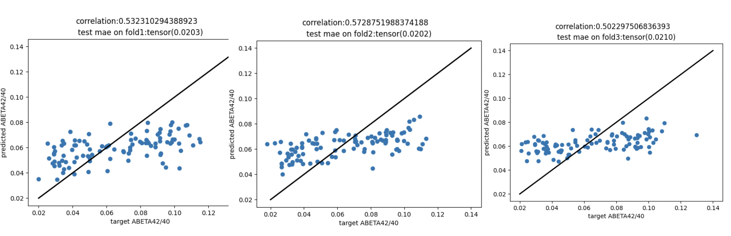
Progress with A-beta prediction
The correlations with VGGNet based global-local transformer is only around 50% which is not good enough for
the prediction. Hence, the accuracy needs to be improved for the a-beta prediction.

Slide 12
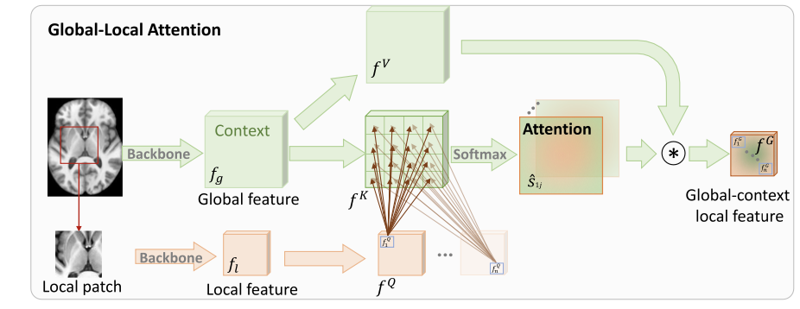
Proposed Method
INCEPTION BASED GLOBAL-LOCAL TRANSFORMER
The backbone network is case of the global-local transformer model in the proposed
literature is a VGGNet . The new model proposed replaces it with inception.

Slide 13
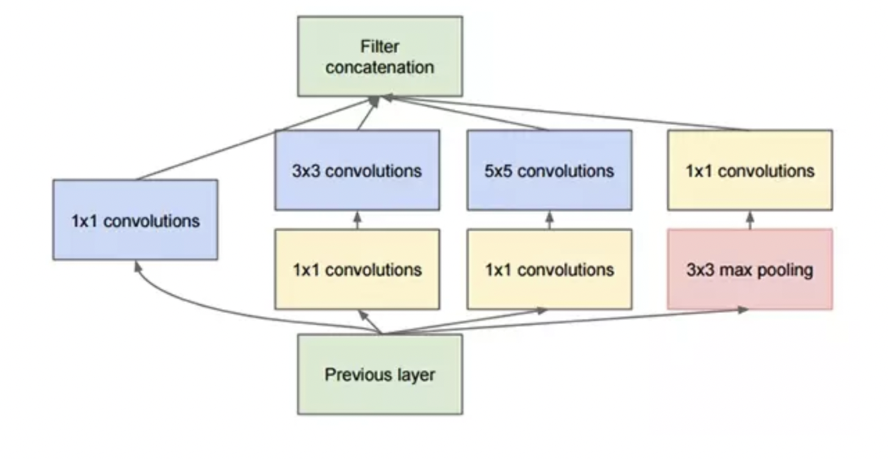
Reason for choosing inception
1. Brain images often show important results with shallow features. Hence, the base paper chose VGGNet8 over ResNet18. Inception chooses features with 1*1, 5*5, 7*7 etc kernels so it takes into account features from all levels. In this way we do not miss out on shallow features. This should improve the accuracy of the model.
2.The 2D frames from around 500 unique subject’s 3D scans is a lot of data to train the model. If working with VGGNet one way to deal with it is to take one frame per person but this might remove lots of important features which is not desired. But with inception, the computational complexity is much less as it uses varied sized kernels to extract different level of features and then concatenates all the filter outputs.

Slide 14
References
https://journals.plos.org/plosone/article?id=10.1371/journal.pone.0235663
https://www.mdpi.com/1422-0067/22/5/2761/html
https://www.nature.com/articles/s41598-018-37769-z
https://www.sciencedirect.com/science/article/pii/S105381191930031X
https://docs.google.com/presentation/d/1mczyNH7_FfB9RqeHRfzVMxPEm2nRzUZXpPdrgCwZtlw/edit#slide=id.p
https://ieeexplore.ieee.org/document/9525077
https://academic.oup.com/brain/article/138/9/2716/310927
https://jamanetwork.com/journals/jamaneurology/fullarticle/775090
https://www.ncbi.nlm.nih.gov/pmc/articles/PMC6976616/
https://www.ncbi.nlm.nih.gov/pmc/articles/PMC7376527/
Github Repos:
https://github.com/topics/alzheimer-disease-prediction
https://github.com/stan-dev/stancon_talks/blob/master/2018/Contributed-Talks/02_pourzanjani/ad_progression.Rmd
https://github.com/grantgasser/Alzheimers-Prediction#prediction-models

